Slide 1
AD HOC Analysis
Dairy Industry

Slide 2
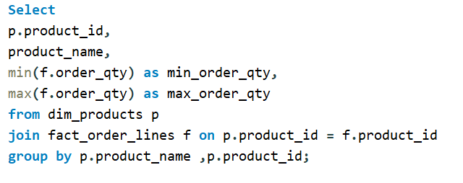
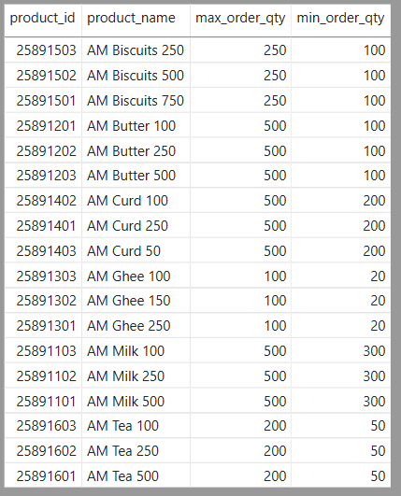
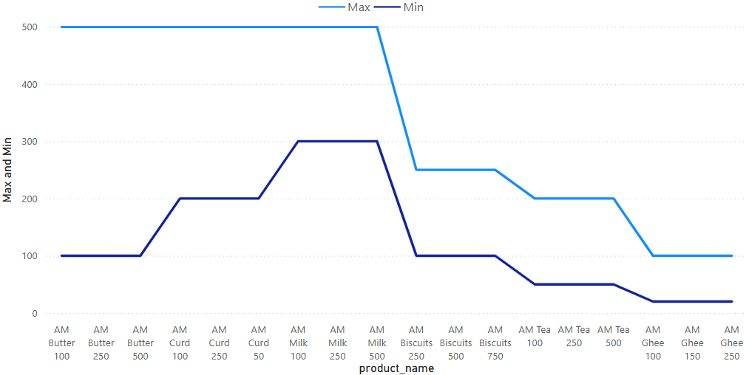
Request : 1 What are the minimum and maximum order quantities for each product ?

Slide 3
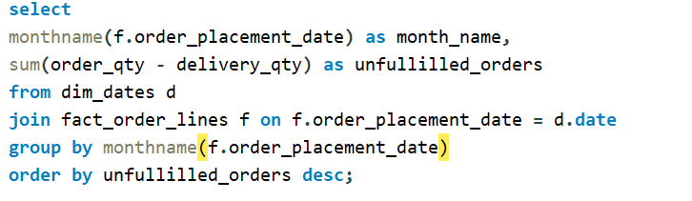
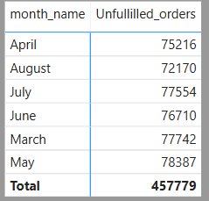
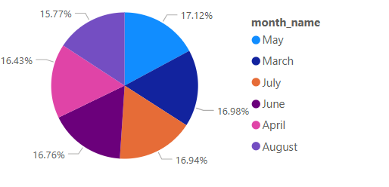
Request : 2 Generate a report with month name and number of unfullfilled_orders(i.e order_qty - delivery_qty) in that respective month

Slide 4
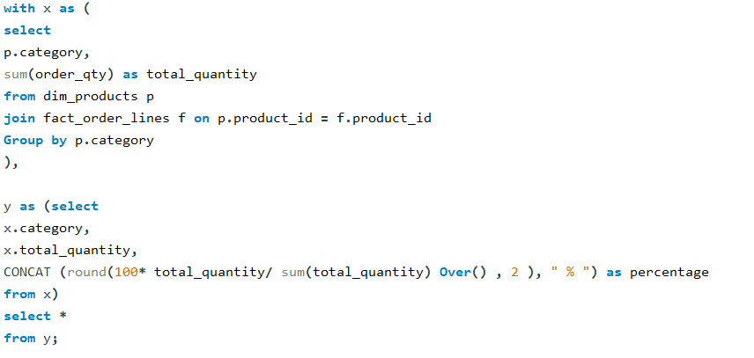
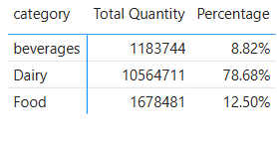
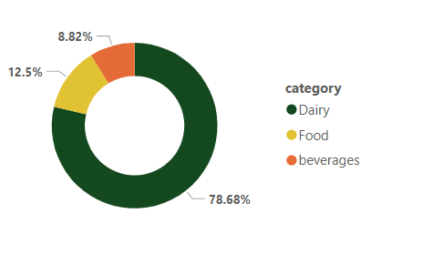
Request 3 : What is the percentage breakdown of order_qty by category?

Slide 5
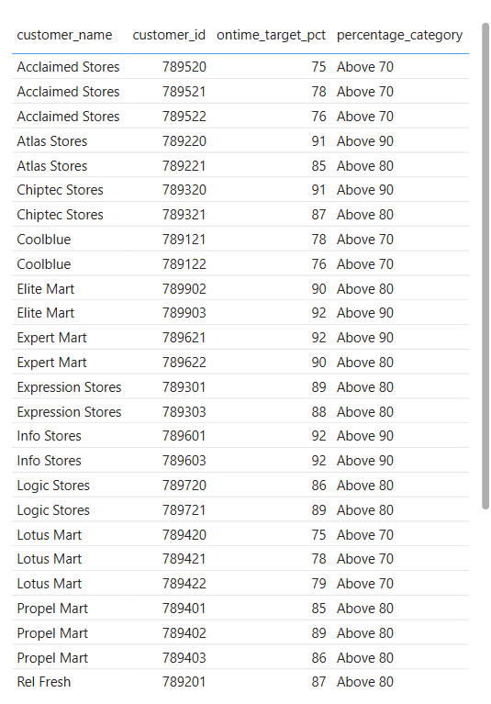
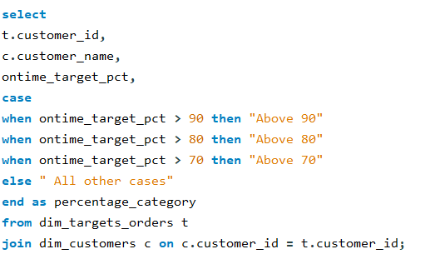
Request 4 : Generate a report that includes the customer ID, customer name, ontime_target_pct, and percentage_category?

Slide 6
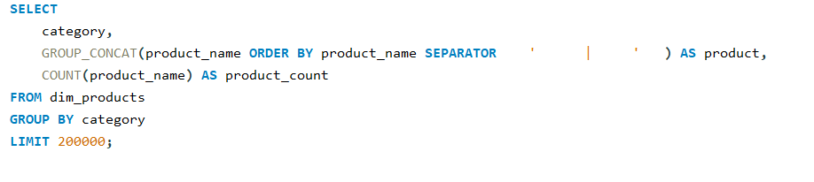
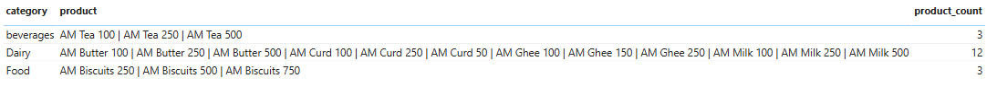
Request 5 : Generate a report that lists all the product categories, along with the product names and total count of products in each category. The output should have three columns: category, products, and product count.

Slide 7
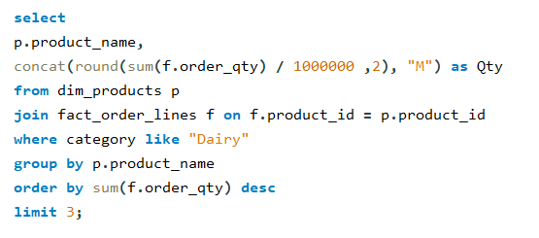
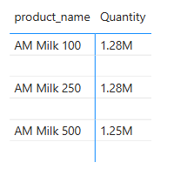
Request 6 : What are the top 3 most demanded products in the 'Dairy' category, and their respective order quantity in millions?
The final output includes the following fields:
Product name
Order quantity millions.

Slide 8
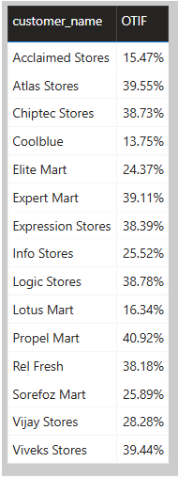
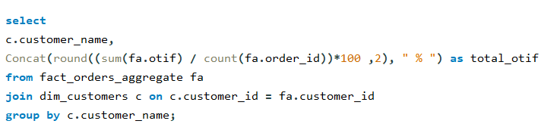
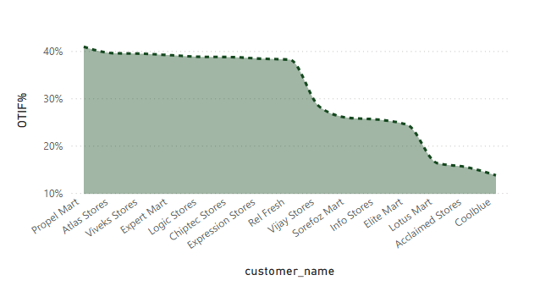
Request 7 : Calculate the OTIF % for a customer named Vijay Stores?
The final output should contain these fields,
Customer_name
OTIF_percentage

Slide 9
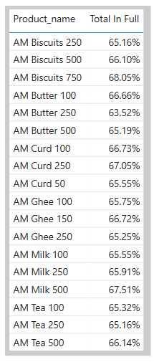
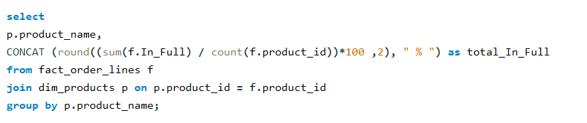
Request 8: a )What is the percentage of 'in full' for each product ? And
b) which product has the highest percentage,?
Based on the data from the ‘Fact_order_lines' and ‘Dim_products'
a )What is the percentage of 'in full' for each product?

Slide 10
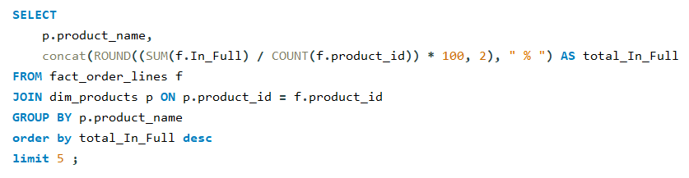
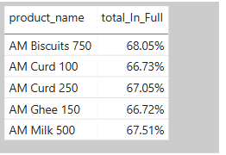
Request : 8 b) which product has the highest percentage(Top 5) ?

